Slide 1
group 7 AIRLINES data analysis with python

Slide 2
Our project objective
Our goal is to analyze a data from January 2018 to December 2018 and extract a meaningful information (how to improve airline customer services) from this data.
For this project, we analyzed over 33 different airlines from our data. We then set out to answer the follow questions:
How does customer satisfaction distributions look like?
How does the average waiting minutes affect customer satisfaction?
How does a flight’s cleanliness, safety and boarding area affect customer satisfaction.

Slide 3
LIBRARIES USED FOR THIS PROJECT
NUMPY
PANDAS
MATPLOTLIB
MISSINGNO
SEABORN

Slide 4
Our data
The dataset contains satisfaction rates and data on factors such as airline type, boarding area, wait minutes, cleanliness, safety, destination and others from over 30 airlines

Slide 5
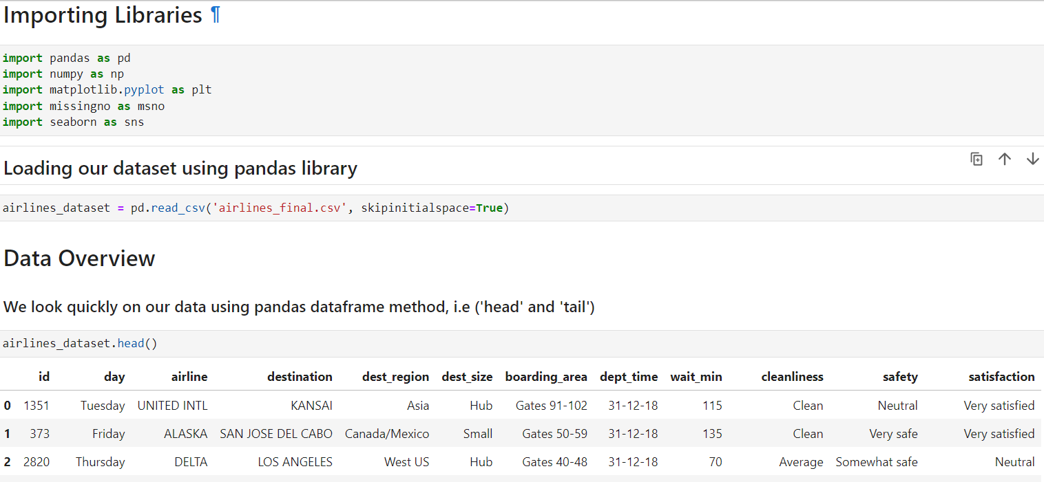
Data cleaning
During our data observation in excel, we identified white spaces in some of columns so we imported the data and set; “skipinitialspace=True”, to get rid of the white spaces.

Slide 6
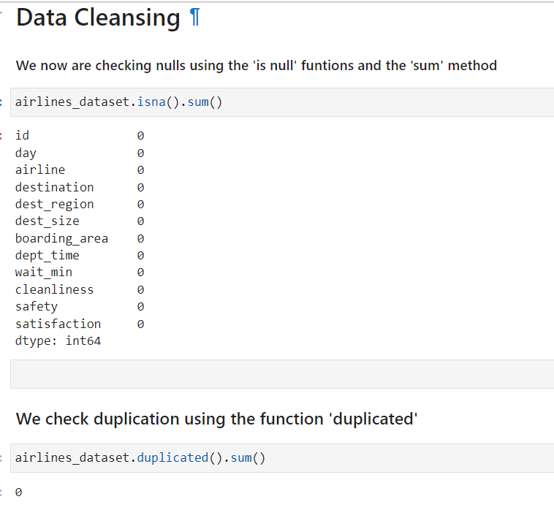
Our data is clean and needs no further cleaning as you can see from the figure below.

Slide 7
Data analysis
During the data analysis, we identified that our airlines dataset is incomplete.
The “day” column has all the seven (7) days of the week but the “dept_time” has on two (2) different dates as we can see from the next slide.

Slide 8
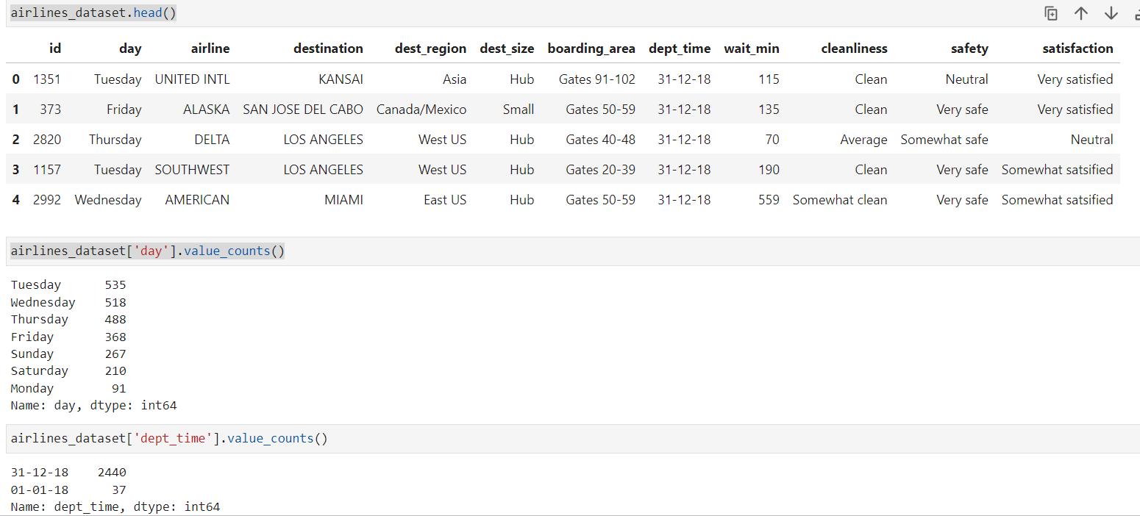

Slide 9
Data visualization

Slide 10
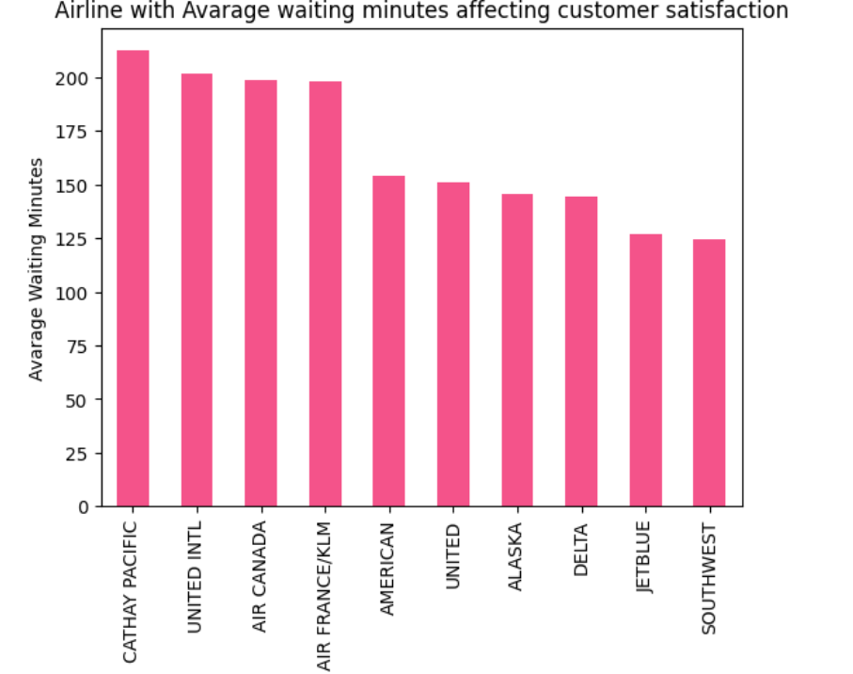
THE AIRLINE WITH THE LONGEST WAIT MINUTES

Slide 11
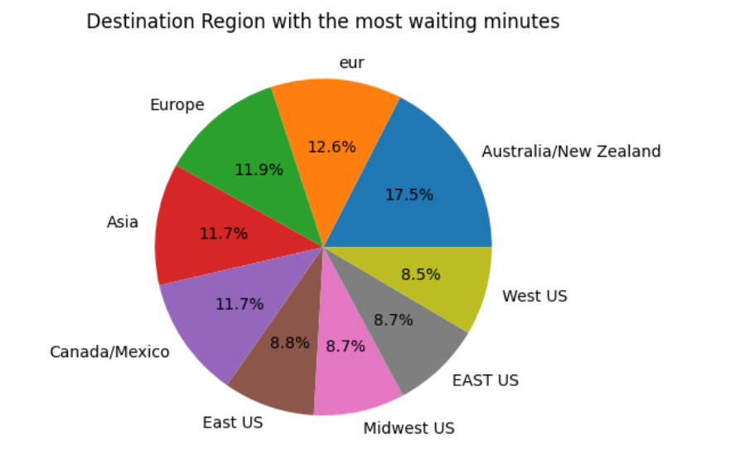
DESTINATION REGION WITH THE LONGEST WAIT MINUTES IN PERCENTAGE

Slide 12
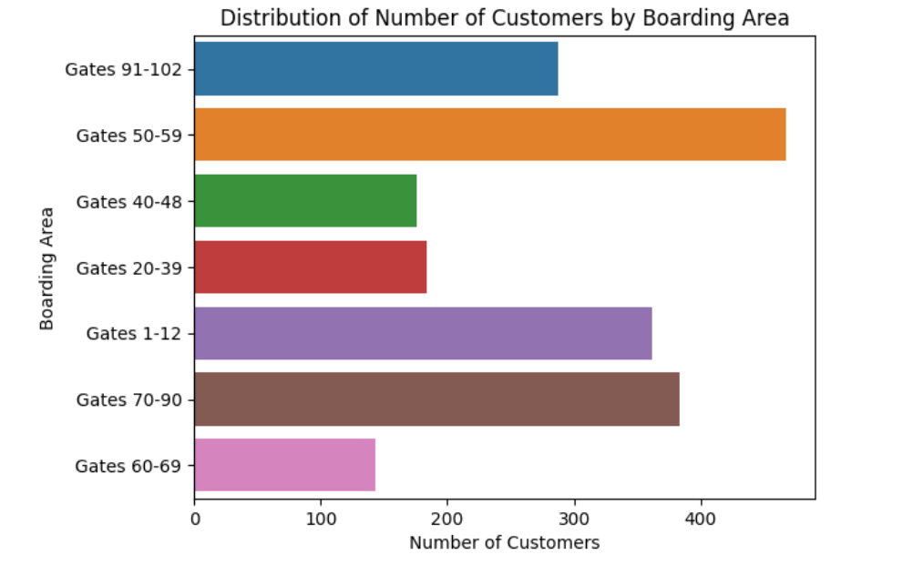
BOARDING AREA WITH THE BUSIEST GATE

Slide 13
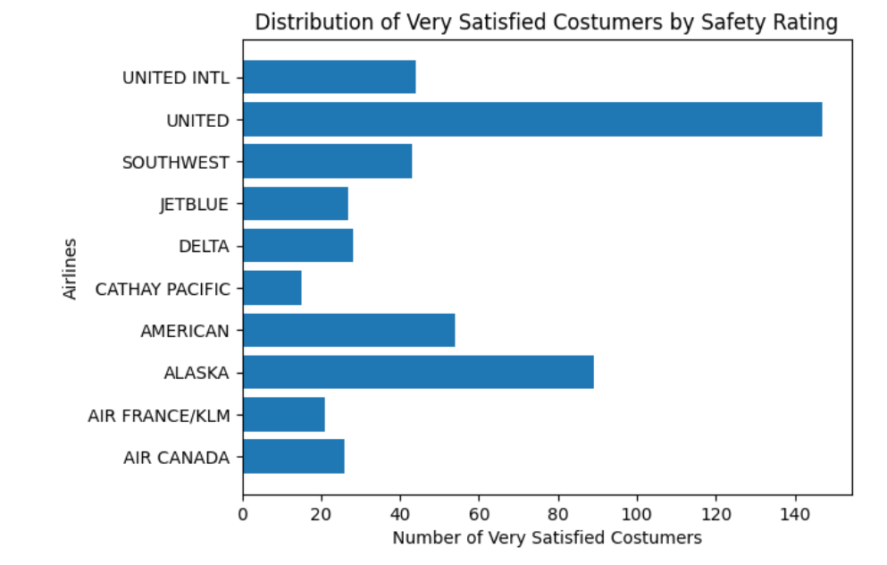
AIRLINE WITH THE BEST SAFETY RATING BASED ON VERY SATISFIED CUSTOMERS

Slide 14
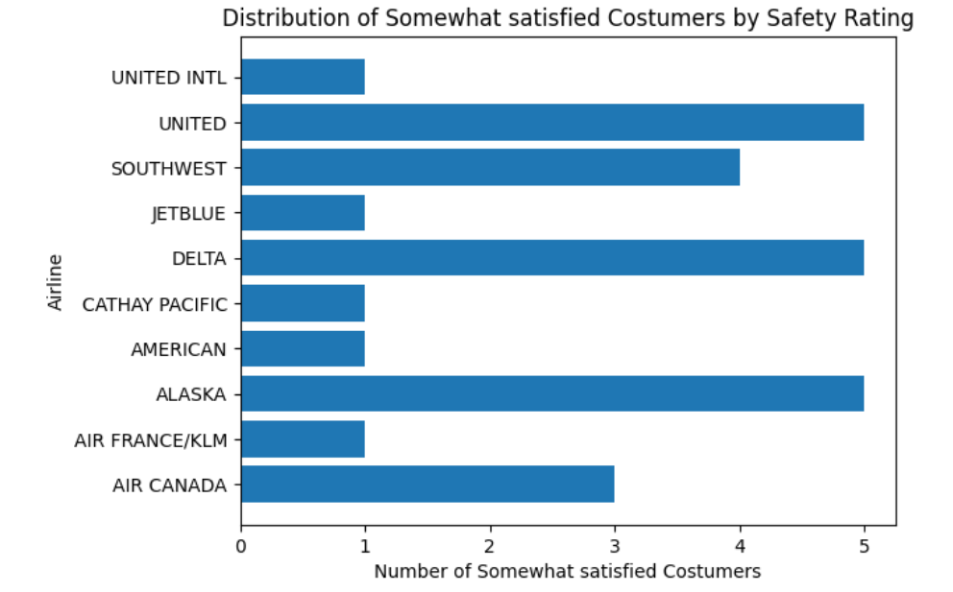

Slide 15
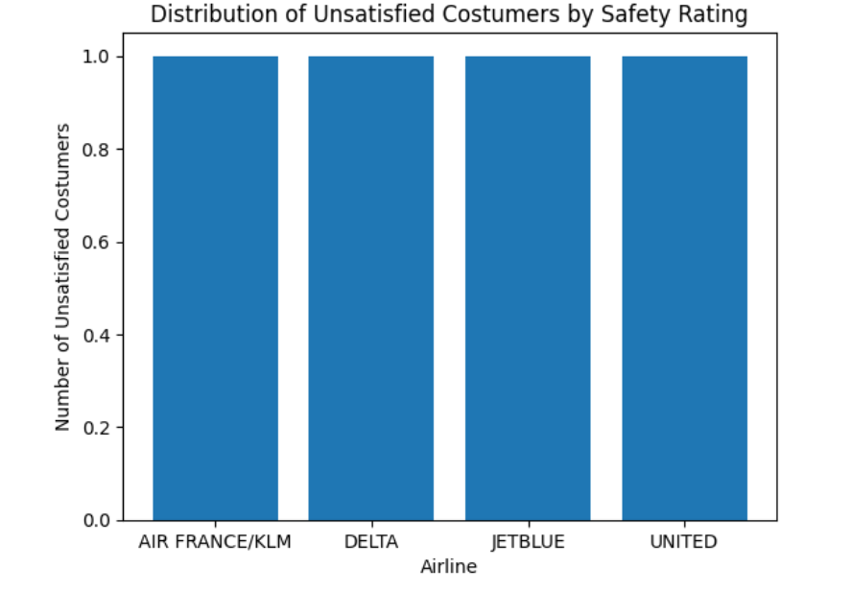

Slide 16
SUMMARY
Conclusively, we found out from our analysis that most of the airlines provide better customer services but there is always more room for improvement. Thus, airlines should put the necessary safety and other measures in place to ensure customer satisfaction.
Thank you.

